Slide 1
Quantum Resource Estimation of the Quantum Approximate Optimization Algorithm (QAOA)
QRISE2024
Special thanks to our sponsor Microsoft
Presentation by the Qu-Cats
Notes:
(add to this slide, Microsoft Logo and make qrise logo on this 1 page bigger)
OK this presentations needs to be a tight 20 and it needs to cater to our audience
If I was at Microsoft, what would I be interested in knowing?
Why should I care
Okay now that I care, what are you doing to improve the situation?
What was the outcome of your work(ie results)
How can things be improved? And how can we benefit from this? Are there reasonings or techniques that can be applied to other systems?
Great you did this, but what did you learn?
5 mins for questions

Slide 2




Meet the Team
M.Sc. Physics
My research interests center on Quantum Learning Theory and its applications in Quantum Machine Learning, especially interested in the role of quantum feature maps in developing efficient quantum kernel algorithms.
B.S. Physics
I am interested in identifying optimal manufacturing methods and materials to overcome hardware limitations and errors in quantum computers, while also developing algorithms to compensate for these hardware constraints( surface code).
Katie Harrison
Muhammad Waqar Amin
Nikhil Londhe
Sarah Dweik
B.S. Physics, Quantum Program Admin
Interested in quantum algorithms, specifically in graph theory and combinatorial optimization. Currently works at the Chicago Quantum Exchange, pursuing personal research interests alongside professional development.
B.S. Physics, Senior Researcher
Interested in developing novel quantum hardware for quantum information processing.

Slide 3
Presentation Agenda
Our goal is to provide reasonable motivation and background on what QAOA is, how it works, and provide based on Microsoft’s resource estimator, quantum parameter values for the best results
Project Selection
Background
Q# implementation of QAOA
Resource Estimation of QAOA
Conclusion and recommended next steps

Slide 4
Project Selection
Project selection took into account topic novelty, applicability, and solvability
Microsoft’s Resource Estimator (RE) has yet to be utilized to predict optimal resource allocation for QAOA implementation on quantum computers
Our project provides resource benchmark recommendations based on Microsoft’s RE
QAOA shows promise for improving the runtime of QUBO problems that are NP
We look at how the Resource Estimations scale with increasing input size
QAOA, Q#, and the Resource Estimator were all relatively new to many of us
Given the time constraint and amount we needed to learn, it was important that our algorithm have a plethora of documentation
Notes:
our goal was to both learn something, and create something that would be beneficial for others in the field
To run QAOA as p approaches infinity, we must first build a near term quantum computer that can accommodate such a task. the first step in building said near term quantum computer is determining the quantum resources needed to build it.
We spent more time reading and watching lectures than almost anything else.
two advantages: complexity and how well/quickly? it can approximate

Slide 5
Quantum Approximate Optimization Algorithm (QAOA)
Background and Overview
QAOA is a Quantum Algorithm used to solve combinatorial optimization problems
Draws inspiration from the Adiabatic Theorem
Encodes the cost function of an optimization problem as H_{c} and alternates it with a mixer H_{m}
High-level Overview
Prepare a quantum state that encodes all potential solutions
Evolve the state using 𝙥 layers
Tune the adjustable parameters (𝞫 and 𝞬) using an optimizer to find the optimal solution

Slide 6
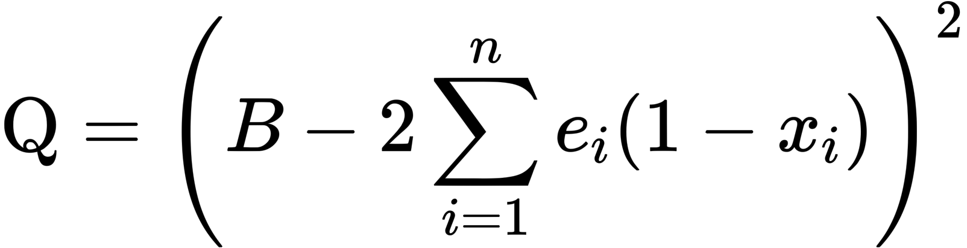
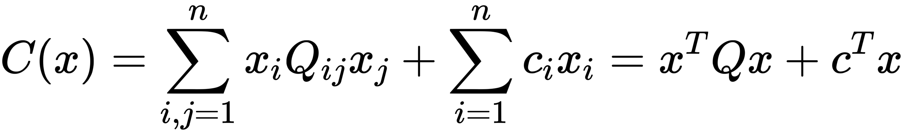
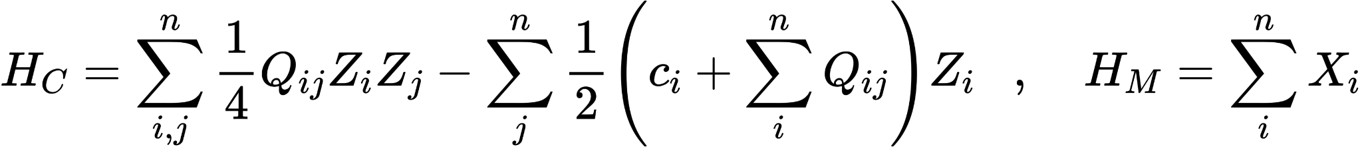
Quantum Approximate Optimization Algorithm (QAOA)
Implementation Walkthrough
Formulate the optimization problem as a QUBO
Express the QUBO cost function as a Hamiltonian H_{c} and add a mixer Hamiltonian H_{m}
Run the QAOA circuit which consists of p layers of the unitary operations U_{c} , U_{m} alternating
Use the results of the QAOA circuit to optimize the parameters using a classical optimizer (COBYLA)
Number Partition Cost function
QUBO Cost function
Cost & Mixer Hamiltonian's
Notes:
The estimates are for a single loop. (usually optimizer has a tolerance so that if the parameter doesn’t change the cost (expectation value) the optimizer stops)
In theory you could use any mixer you want, because the idea is simply to put your qubits in superposition of all the states. we use Xi because it’s easy to prepare

Slide 7
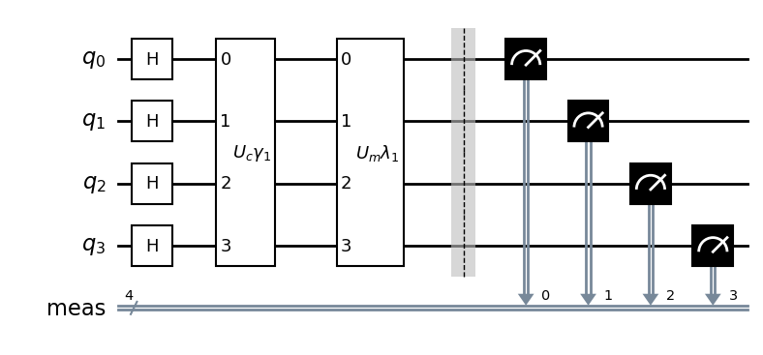
QAOA Quantum Circuit and Classical Optimizer
Q#
QAOA Output Measurement
Calculate Expectation Values
Python
Updated QAOA Parameters
Classical Optimizer
Notes:
We run our Hamiltonian on a quantum computer, output possible partition splits as bit-strings, optimizer the parameters based on the mean of partition splits, and repeat the process with our new parameters

Slide 8
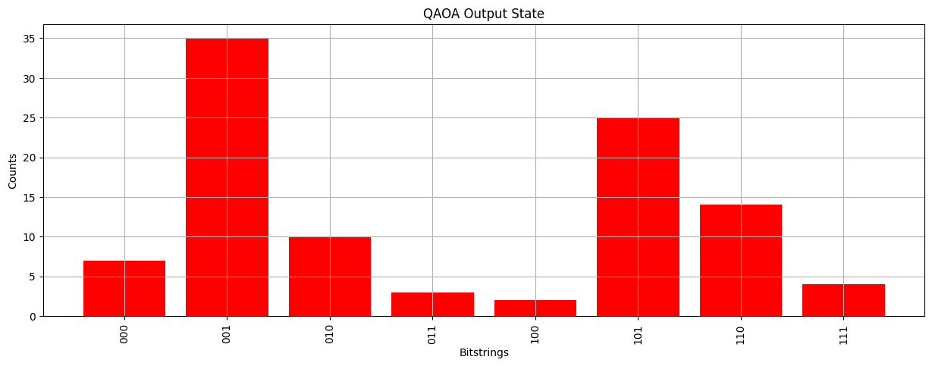
QAOA Test Example Results
Our sample problem is partitioning a list ([1,5,6]) into two lists such that the difference between the sums of the two partitions is minimized.
The graph shows the frequency output of our QAOA circuit
Bit string represents the indices of the array.
A = [1,5,6]
S = ‘001’ → [6] → Sum(S) = 6
S/A = [1,5] → Sum(S/A) = 6
The difference in sums is, abs[Sum(S) - Sum(S/A)] = 0

Slide 9
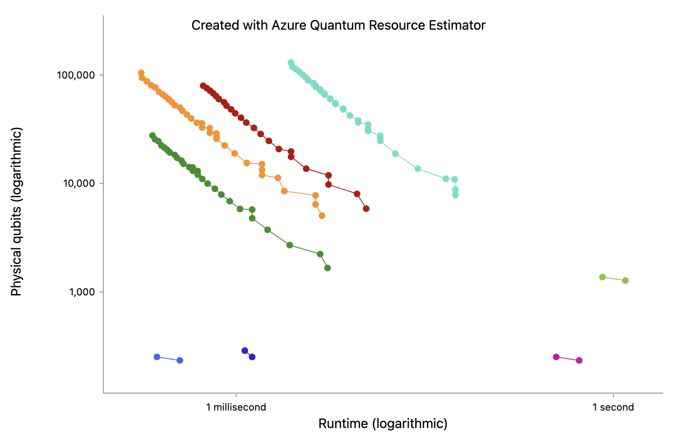
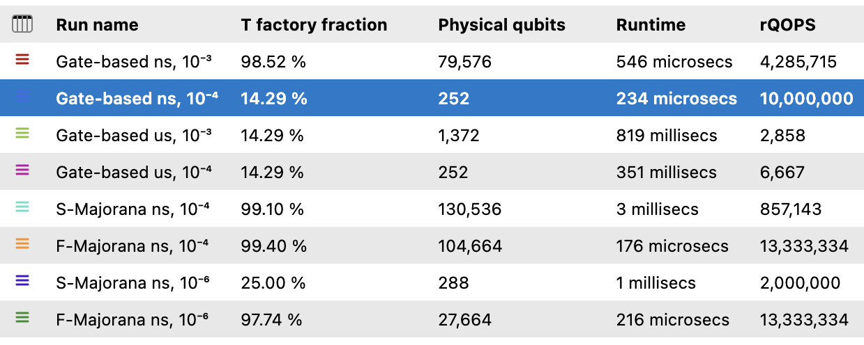
Results
The Superconducting/ spin qubit based quantum computer stands out as the top performer, achieving optimal results with minimal physical qubits, significantly reduced processing time, and a lower T-factory ratio
Notes:
Once we tested that our quantum circuit and classical optimizer worked to our satisfaction, we proceeded to apply Microsoft’s Resource Estimator Algorithm to our QAOA Circuit (quantum representation of the number partition problem) to determine the number and of resources needed to compute the quantum circuit and to determine the configuration of parameters that would give us the highest chance of success, while requiring the fewest resources.
1.Our first step was to run and compare the various combinations of qubit types and error correction schemes
at this step we had a total of 8 jobs, 3 different system setups including ion qubits, superconducting qubits, and Majorana qubits. for each system we ran a 1 job that computed a realistic and 1 job that computed the optimistic error rate target.
all Gate_Based jobs were run using the “surface_code” quantum error correction scheme, and the Majorana based qubits explored both a surface and Floquet error correction scheme.
1.The graph shown here was made using Azure Quantum’s Estimate Overview function, all the values you see were measured with an error budget of 33.3%
2.The job that stands out as the best performer is the Gate_based superconducting qubit quantum computer with an optimistic 14.29% T Factory Fraction percentage (which is the percentage of total physical qubits that goes into making the T factories), 252 physical qubits, a runtime of 234 microsecs, and a rQOPS of 10 million
1.To confirm that this was a good option we moved onto phase two of analysis. Examining our error budget (next slide)
(if time permits add: we chose to start 33% as our error Budget threshold because of 2 reasons. number 1. we wanted to give every a chance to show their best possible outcome, we can always do more error correction later. reason number 2. our solution only has about a 35-50% success rate, but that is good enough to get the right answer.)

Slide 10
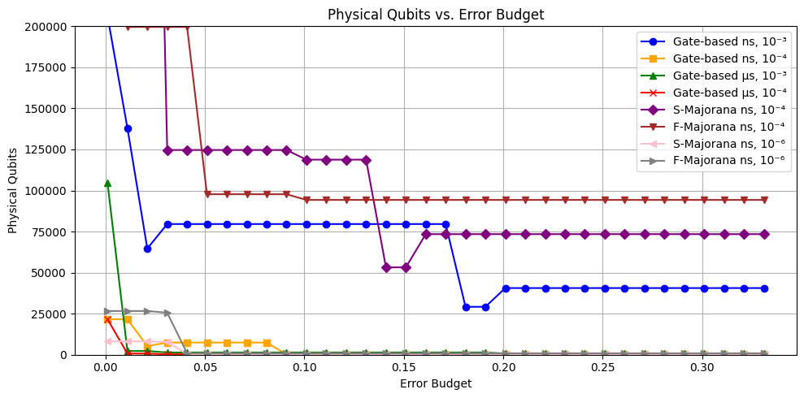
Determining the optimal trade-off between
performance and error budget
The Graphs show a comparison of the Error Budget vs.
The number of Physical Qubits required
~9% error budget
Notes:
We ran a test comparison for the jobs, comparing the Number of Physical Qubits, the Physical Run time, the T Factory Fraction Percentage, as well as additional parameters, all against the range of error rates
our results not only confirmed that the Gate_based superconducting qubit quantum computer with the “surface_code” quantum error correction scheme is the best set of parameters to run our algorithm on, it also showed us that we can reduce the error budget from 33.3% to just above 9% and still achieve the same results
The Job in yellow is the job that we found performed the best.
Based on the Resource Estimator results, our recommendation to other attempting to solve a quadratic unconstrained binary optimization problem on Microsoft’s quantum software is that they use the superconducting qubit based quantum computer with “surface_code” as quantum error correction scheme and an error rate budget of 9%
TFactory Fraction: 14.29 %
number of physical qubits needed:252
physical time required: 234 microsecs
number of Quantum operations that can be performed per sec: 10,000,000
We ran a test comparison for the jobs, comparing the Number of Physical Qubits, the Physical Run time, the T Factory Fraction Percentage, as well as additional parameters, all against the range of error rates
our results not only confirmed that the Gate_based ion quantum computer with the “surface_code” quantum error correction scheme is the best set of parameters to run our algorithm on, it also showed us that we can reduce the error budget from 33.3% to just above 9% and still achieve the same results
The Job in yellow is the job that we found performed the best.
Based on the Resource Estimator results, our recommendation to others attempting to solve a quadratic unconstrained binary optimization problem on Microsoft’s quantum software is that they use the ion based quantum computer with “surface_code” as quantum error correction scheme and an error rate budget of 9%, and an even split of the error budget between
implement logical qubits
production of T states through distillation
synthesis of rotation gates
TFactory Fraction: 14.29 %
number of physical qubits needed:252
physical time required: 234 microsecs
number of Quantum operations that can be performed per sec: 10,000,000

Slide 11
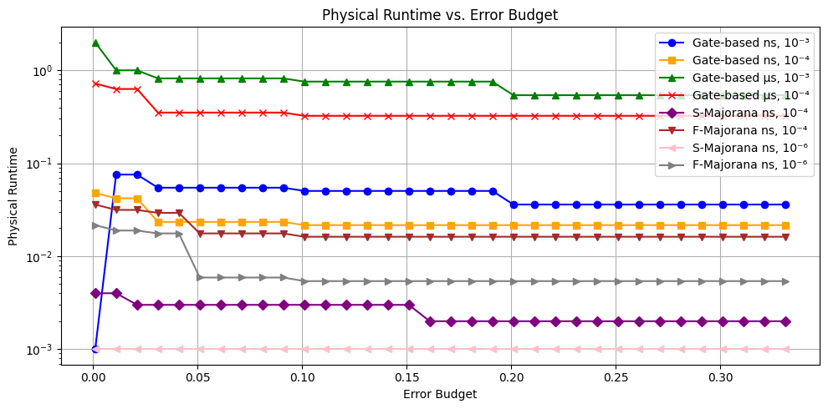
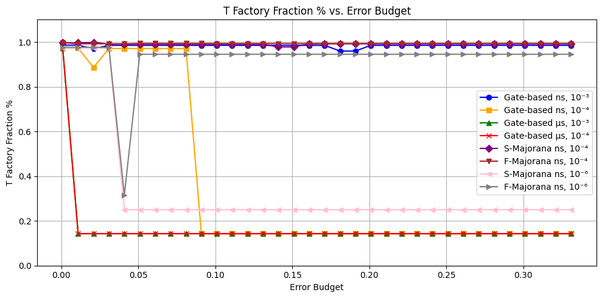
Determining the optimal trade-off between
performance and error budget
~9% error budget
~9% error budget
The Graphs show a comparison of the Error Budget vs.
The T Factory Fraction %
The Physical Run Time
Notes:
We ran a test comparison for the jobs, comparing the Number of Physical Qubits, the Physical Run time, the T Factory Fraction Percentage, as well as additional parameters, all against the range of error rates
our results not only confirmed that the Gate_based superconducting qubit quantum computer with the “surface_code” quantum error correction scheme is the best set of parameters to run our algorithm on, it also showed us that we can reduce the error budget from 33.3% to just above 9% and still achieve the same results
The Job in yellow is the job that we found performed the best.
Based on the Resource Estimator results, our recommendation to other attempting to solve a quadratic unconstrained binary optimization problem on Microsoft’s quantum software is that they use the superconducting qubit based quantum computer with “surface_code” as quantum error correction scheme and an error rate budget of 9%
TFactory Fraction: 14.29 %
number of physical qubits needed:252
physical time required: 234 microsecs
number of Quantum operations that can be performed per sec: 10,000,000
We ran a test comparison for the jobs, comparing the Number of Physical Qubits, the Physical Run time, the T Factory Fraction Percentage, as well as additional parameters, all against the range of error rates
our results not only confirmed that the Gate_based ion quantum computer with the “surface_code” quantum error correction scheme is the best set of parameters to run our algorithm on, it also showed us that we can reduce the error budget from 33.3% to just above 9% and still achieve the same results
The Job in yellow is the job that we found performed the best.
Based on the Resource Estimator results, our recommendation to others attempting to solve a quadratic unconstrained binary optimization problem on Microsoft’s quantum software is that they use the ion based quantum computer with “surface_code” as quantum error correction scheme and an error rate budget of 9%, and an even split of the error budget between
implement logical qubits
production of T states through distillation
synthesis of rotation gates
TFactory Fraction: 14.29 %
number of physical qubits needed:252
physical time required: 234 microsecs
number of Quantum operations that can be performed per sec: 10,000,000

Slide 12
Recommendation
Superconducting Qubits
Surface Code
9%
Even Split
Quantum Computer machine type
Error Correction Scheme
Total Error Budget allowed
Error Budget split evenly 3 ways
Implementation of logical qubits
Production of T states
Synthesis of rotation gates
If you configure your parameters as described and attempt the number partition problem using the QAOA method for a list of three elements, the resource estimations will indicate the necessity of 252 physical qubits and 234 microseconds of runtime. Moreover, approximately 14% our your physical qubits will go into T factory creation and you can reliably compute 10 million quantum operations per second.
Notes:
If you configure your parameters as described and attempt the number partition problem using the QAOA method for a list of three elements, the resource estimations will indicate the necessity of 252 physical qubits and 234 microseconds of runtime. Moreover, approximately 14% our your physical qubits will go into T factory creation and you can reliably compute 10 million quantum operations per second.
this was phase 2 of our analysis, once we determined the best scheme for our problem and the best error budget, the next step was to see how these values changed as we increased the input list size.
Once we determined the best set of initial parameters, the next step was to see how the quantum resource estimates changed as we increased the number of elements in our input list.

Slide 13
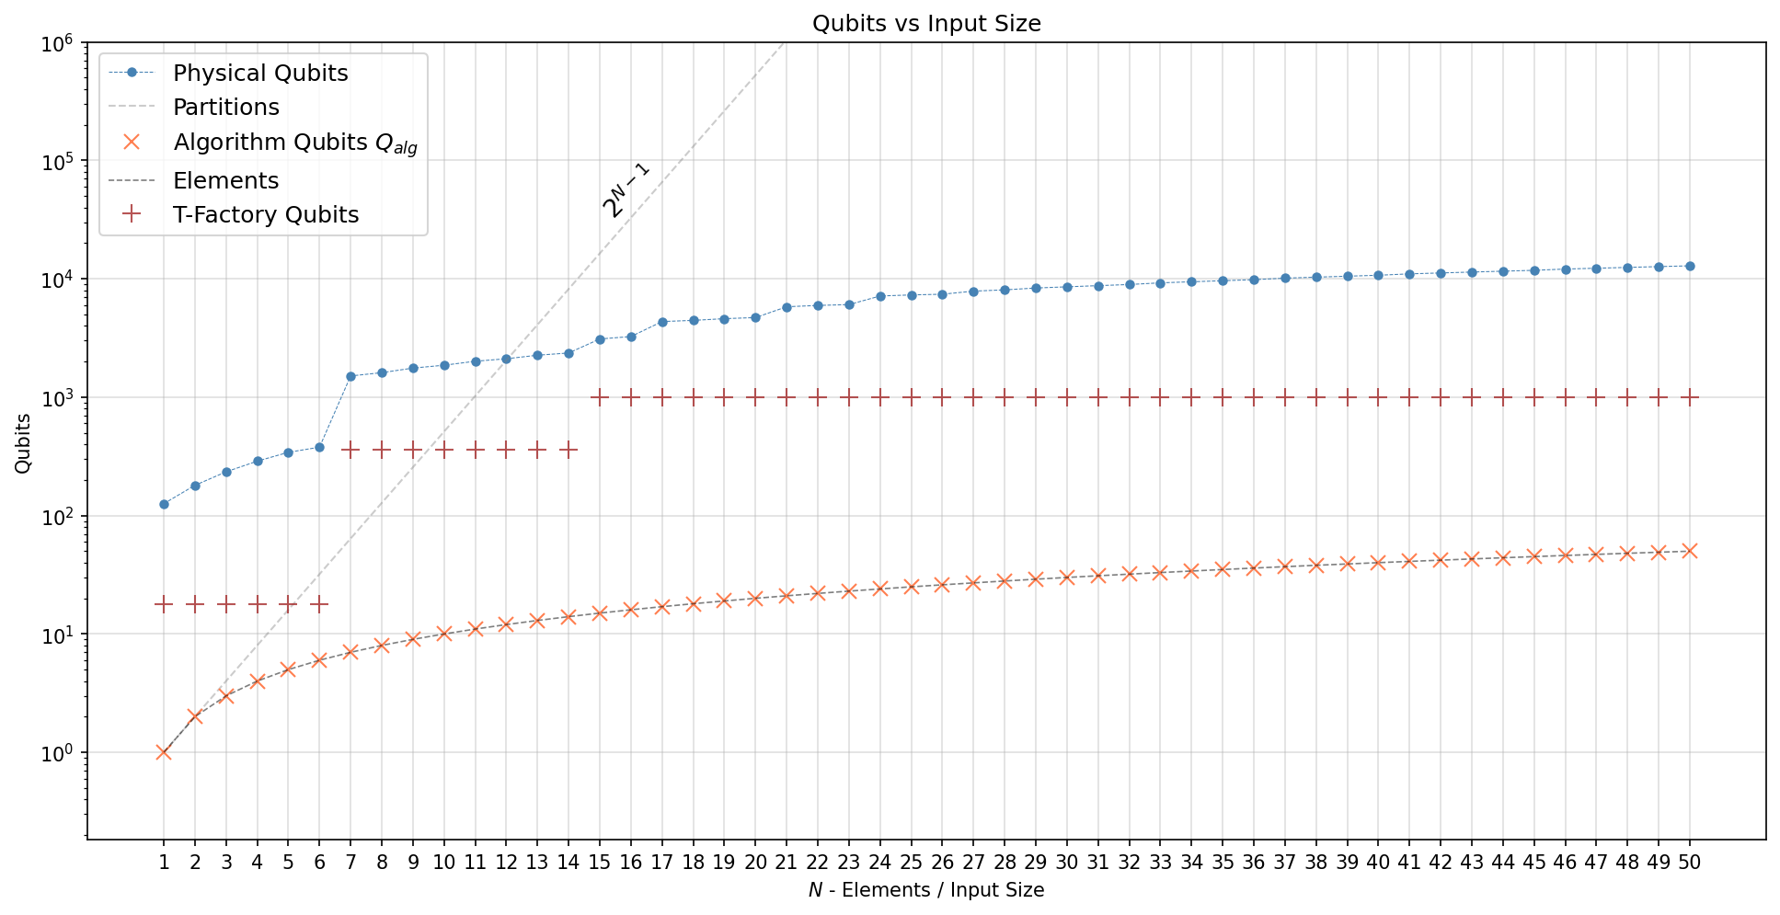
Resource Estimation for varying input sizes
‘qubit_gate_ns_e4’
Gate-based
Spin Qubits or Superconducting Qubits
QECC: Surface Code
Error Budget: 0.1
Layers: 1
Max Duration: 3 s
Notes:
This is a plot for physical Qubits required for running QAOA as we vary the input size for our problem NPP.
We have chosen the following QPU parameters for our analysis (error budget, depth and QECC scheme).
Physical Qubits increase with increase input size (no. of elements in the list for NPP) - this expected as we require n bits for n elements. So the algorithm logical qubits increase linearly with input size.
Observations
But we should also look for the number of possible solution for our problem. We know this scale exponentially (n bits for n input size). This is important as we can compare with the brute force solution, in which one would go through all the partitions and check for the solution. We observe that upto 12 elements the number of physical qubits is more than no. of partitions and hence use of Quantum Computing for solving this problem is not recommended. And we might as well use brute force instead.
Sharp jump in physical qubit number from 6 to 7 elements. Is explained by the change in code distance and no. of qubits per tfactory (no. of Qubits for Tfactory).

Slide 14
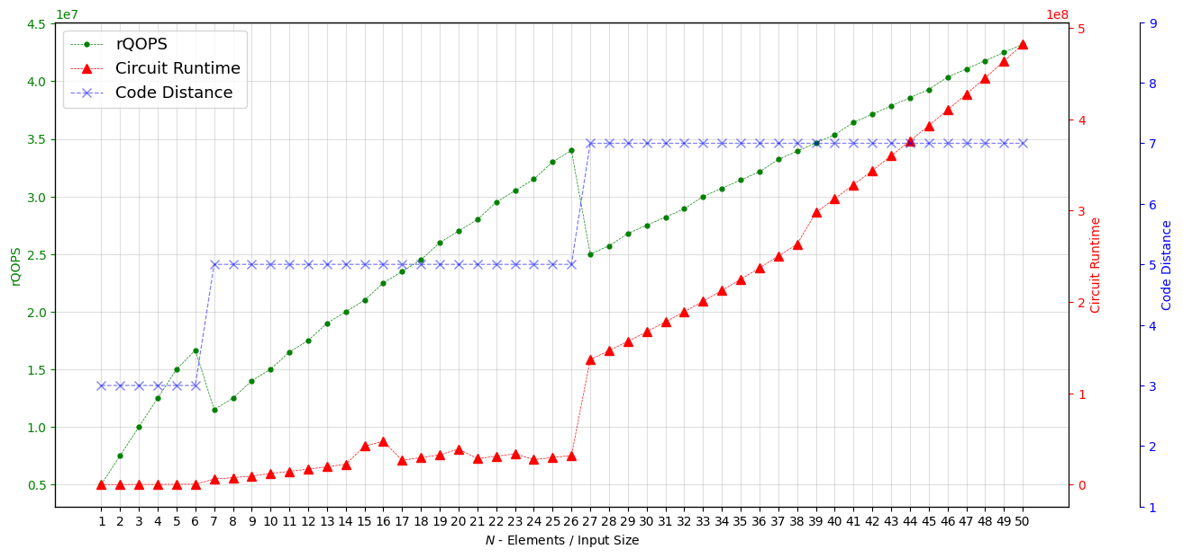
Resource Estimation for varying input sizes
‘qubit_gate_ns_e4’
Gate-based
Spin Qubits or Superconducting Qubits
QECC: Surface Code
Error Budget: 0.1
Layers: 1
Max Duration: 3 s
Notes:
This is a plot for rQOPS, Circuit Runtime and Code Distance.
Observations
Every metric seems to increase with the input size.
But we observe interesting drop in reliable operations (rQOPS) whenever the code distance changes (6 to 7 and 26 to 27). This due to fact that when CD (Code Distance) increases we need more physical qubits for a single logical qubit. Since the clock speed in independent of input size the number of reliable operations drop whenever the code distance increases.
Another interesting observation is the sudden jump in runtime when we go from 26 to 27 elements.

Slide 15
Conclusion
Successfully created a working implementation of QAOA using Q# and Python
Our project pinpoints specific QPU parameters that minimize resources for effective QAOA execution
Created a project that can be used for benchmarking different optimization problems that use QAOA
Notes:
After choosing to focus on a number partitioning problem and learning how to implement it’s quantum circuit representation in Q# sharp, we successfully calculated the quantum resources needed to run instance of QAOA for 3-40 elements.
in short,
Successfully created a working implementation of QAOA using Q# and Python
Our project pinpoints specific QPU parameters that minimize resources for effective QAOA execution
Created a project that can be used for benchmarking different optimization problems that use QAOA
There is still much to be done, next slide
There is still much to be done, including a closer study of the anomalies in resource estimations when going from 6-7 and 13-14 qubits.
within the given time frame we,
Successfully created a working implementation of QAOA using Q# and Python
pinpointed specific QPU parameters that minimize resources for effective QAOA execution, and were the first to do so using Microsoft's resource estimator algorithm
and, we created a project that can be used for benchmarking different optimization problems that use QAOA.
possible next steps if we had more time (next slide)

Slide 16
Possible Next Steps
Explore QAOA circuit resource estimates with varying layer counts
Conduct further study of the Resource Estimator parameters
Explore additional Optimizers both Classical and Quantum
Survey other variants of QAOA
Notes:
Explore QAOA circuit resource estimates with varying layer counts
Conduct further study of the Resource Estimator parameters
Explore additional Optimizers both Classical and Quantum
Survey other variants of QAOA
but we’re looking forward to continuing the research, (next slide)
Questions:
can you run the circuits without an quantum Error Correction scheme? if not, can you add that functionality? because what if we want to use Error Mitigation and not error correction.
where did the mixer hamiltonian equation come from? specifically why is it a single X gate?

Slide 17
THANKS
Presented by the Qu-Cats
Special thanks to QRISE and Microsoft for supporting this project
Notes:
Thank you very much for listening to and supporting this project, at this time we’ll take any questions
and if there are no questions, we have some of our own to ask
Questions:
can you run the circuits without an quantum Error Correction scheme? if not, can you add that functionality? because what if we want to use Error Mitigation and not error correction.
where did the mixer hamiltonian equation come from? specifically why is it a single X gate?

Slide 18
References
[1] Blekos, K., Brand, D., Ceschini, A., Chou, C.-H., Li, R.-H., Pandya, K., Summer, A., et al. "A Review on Quantum Approximate Optimization Algorithm and its Variants." arXiv:2306.09198v2 [quant-ph], June 28, 2023. https://arxiv.org/abs/2306.09198v2.
[2] Farhi, E., Goldstone, J., & Gutmann, S. "A Quantum Approximate Optimization Algorithm." arXiv:1411.4028 [quant-ph], (arXiv:1411.4028), November 2014. https://arxiv.org/abs/1411.4028.
[3] Glover, F., Kochenberger, G., & Du, Y. "A Tutorial on Formulating and Using QUBO Models." arXiv:1811.11538 [cs.DS], (arXiv:1811.11538), 2019. https://arxiv.org/abs/1811.11538.
[4] Lotshaw, P.C., Nguyen, T., Santana, A. et al. "Scaling quantum approximate optimization on near-term hardware." Sci Rep 12, 12388 (2022). https://doi.org/10.1038/s41598-022-14767-w.
[5] Mazumder, A., & Tayur, S. "Five Starter Problems: Solving Quadratic Unconstrained Binary Optimization Models on Quantum Computers." January 17, 2024. https://arxiv.org/abs/2401.08989v1.

Slide 19

Resource Estimation for varying input sizes
‘qubit_gate_ns_e4’
Gate-based
Spin Qubits or Superconducting Qubits
QECC: Surface Code
Error Budget: 0.09
Depth: 1
Max Duration: 3 s
Notes:
qubit_gate_ns_e4
This is a plot for physical Qubits required for running QAOA as we vary the input size for our problem NPP.
We have chosen the following QPU parameters for our analysis (error budget, depth and QECC scheme).
Physical Qubits increase with increase input size (no. of elements in the list for NPP) - this expected as we require n bits for n elements. So the algorithm logical qubits increase linearly with input size.
Observations
But we should also look for the number of possible solution for our problem. We know this scale exponentially (n bits for n input size). This is important as we can compare with the brute force solution, in which one would go through all the partitions and check for the solution. We observe that upto 17 elements the number of physical qubits is more than no. of partitions and hence use of Quantum Computing for solving this problem is not recommended. And we might as well use brute force instead.
Sharp jump in physical qubit number from 6 to 7 elements and 13 to 14 elements. Is explained by no. of qubits per tfactory.
Slight Dip in physical qubits from 10 to 11 elements.

Slide 20
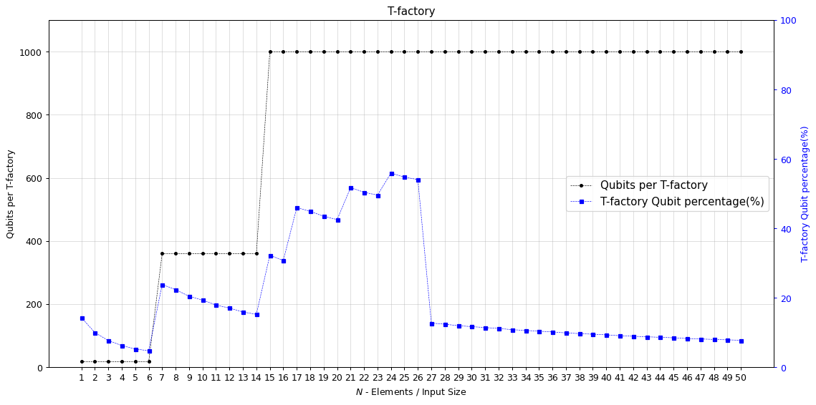
Resource Estimation for varying input sizes
‘qubit_gate_ns_e4’
Gate-based
Spin Qubits or Superconducting Qubits
QECC: Surface Code
Error Budget: 0.1
Layers: 1
Max Duration: 3 s

